Slide 1
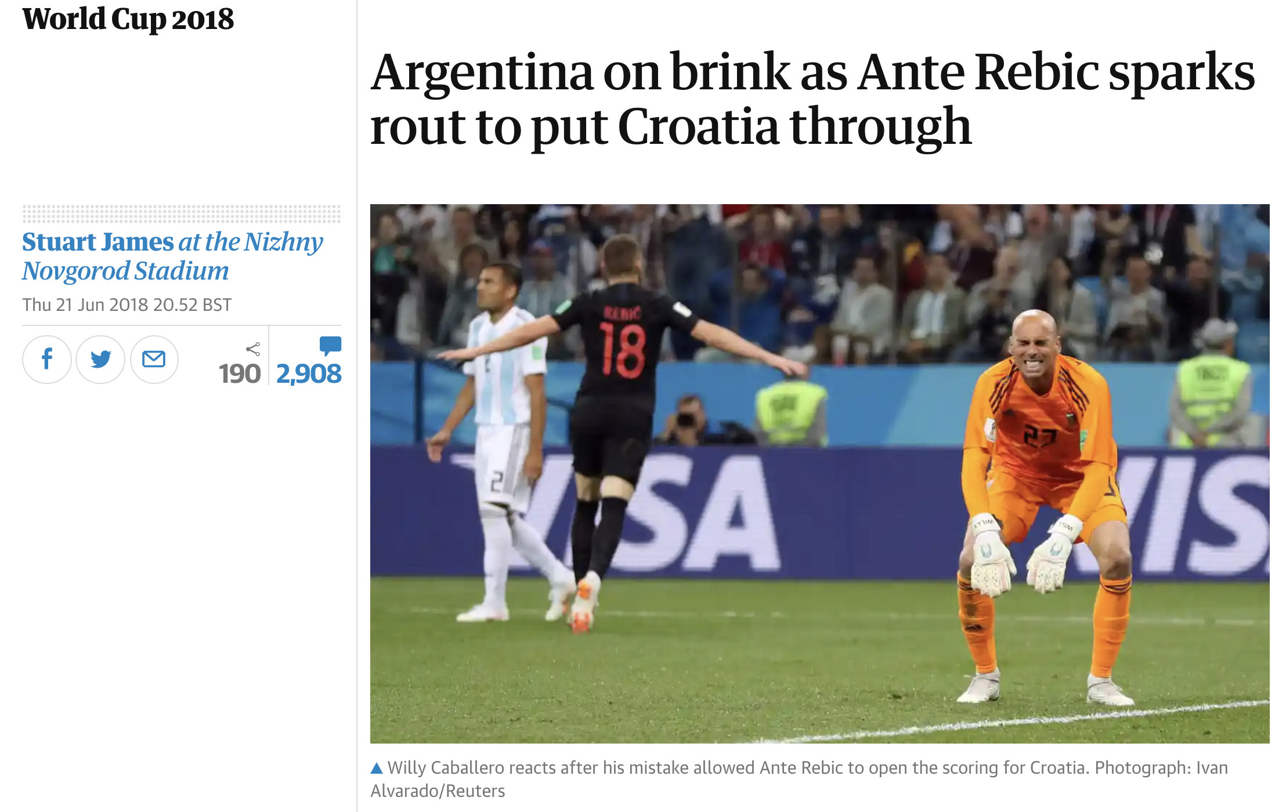
Argentina squeaked through their group after a 1-1 draw with Iceland and a 3-0 thumping to Croatia, before losing to eventual winners France in the Round of 16.
Whilst Messi and Argentina didn’t have an amazing World Cup, I wondered whether he was still the best out and out, schoolboy style dribbler at the tournament.
There are a handful of fascinating approaches to valuing actions, like dribbling, such as VAEP, g+, and xT, that would value the action of a dribble (in units of goals) by the increased likelihood that that action had on a goal being scored at the end of the possession sequence. But for this particular question, I wasn’t too bothered about goals!
By schoolboy style dribbler, I mean the pure ability to beat another player by dribbling past them, like I used to love doing as a 14-year-old kid with a pair of silver Mercurial Vapors playing Wembley Singles. The award for best dribbler shouldn’t just go to the biggest ball hog: dribblers should be rewarded more handsomely the better the defender they beat – and they should be penalised if they give the ball away.
Was Messi the best dribbler at WC2018?

Slide 2
Dribbler Vs Defence: Elo Scores
The top 5 dribblers…
(All Elo scores were initialised at 100 points)
To rank dribblers (and the ability to defend the dribble), I’ve implemented a modified mean Elo rating system using Statsbomb event data.
Usually, the two sides of an Elo competition are trying to achieve the same objective: to win a game. In this instance, there are two objectives:
The dribbler objective is to beat his man;
The defensive objective is to stop them.
Thus, we want to reward dribblers with points and penalise defenders if the first objective is achieved, and vice versa if the second is achieved, hence two scores.
Out of 503 players that attempted at least one dribble, Messi ranks fifth.
The surprise winner is Croatia’s Ante Rebić. Neymar comes a close second, attempting significantly more dribbles with 39 compared to Rebić’s 16. This result showcases a useful property of Elo scoring: star players who see more of the ball don’t necessarily come out on top (like may happen with additive action value methods).
Rank | Player | Elo Score Dribbler | Elo Score Defence
1 | Ante Rebić | 215.3 | 56.0
2 | Neymar | 210.5 | 99.5
3 | Isco | 201.6 | 112.1
4 | Luka Modrić | 200.0 | 82.6
5 | Lionel Messi | 199.7 | 88.9
Neymar lost the ball on more occasions to Costa Rica alone – one of the weakest teams in the competition – than Rebić did in the entire tournament.
Rebić’s successful dribbling past stiffer opposition on his way to the final was highly rewarding, whilst Neymar’s score was heavily penalised for frequently losing the ball to weaker opponents.
To dig deeper into styles and effectiveness of dribbling, we can take a look at Messi and Rebić’s dribbles with an Elo overlay for the defenders trying to stop them.

Slide 3
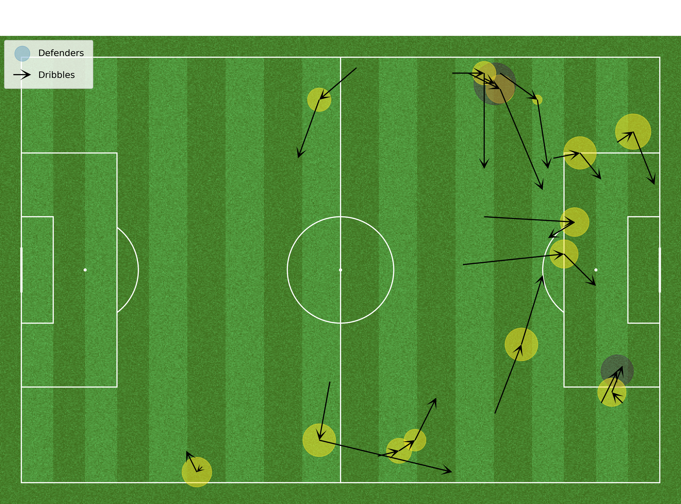
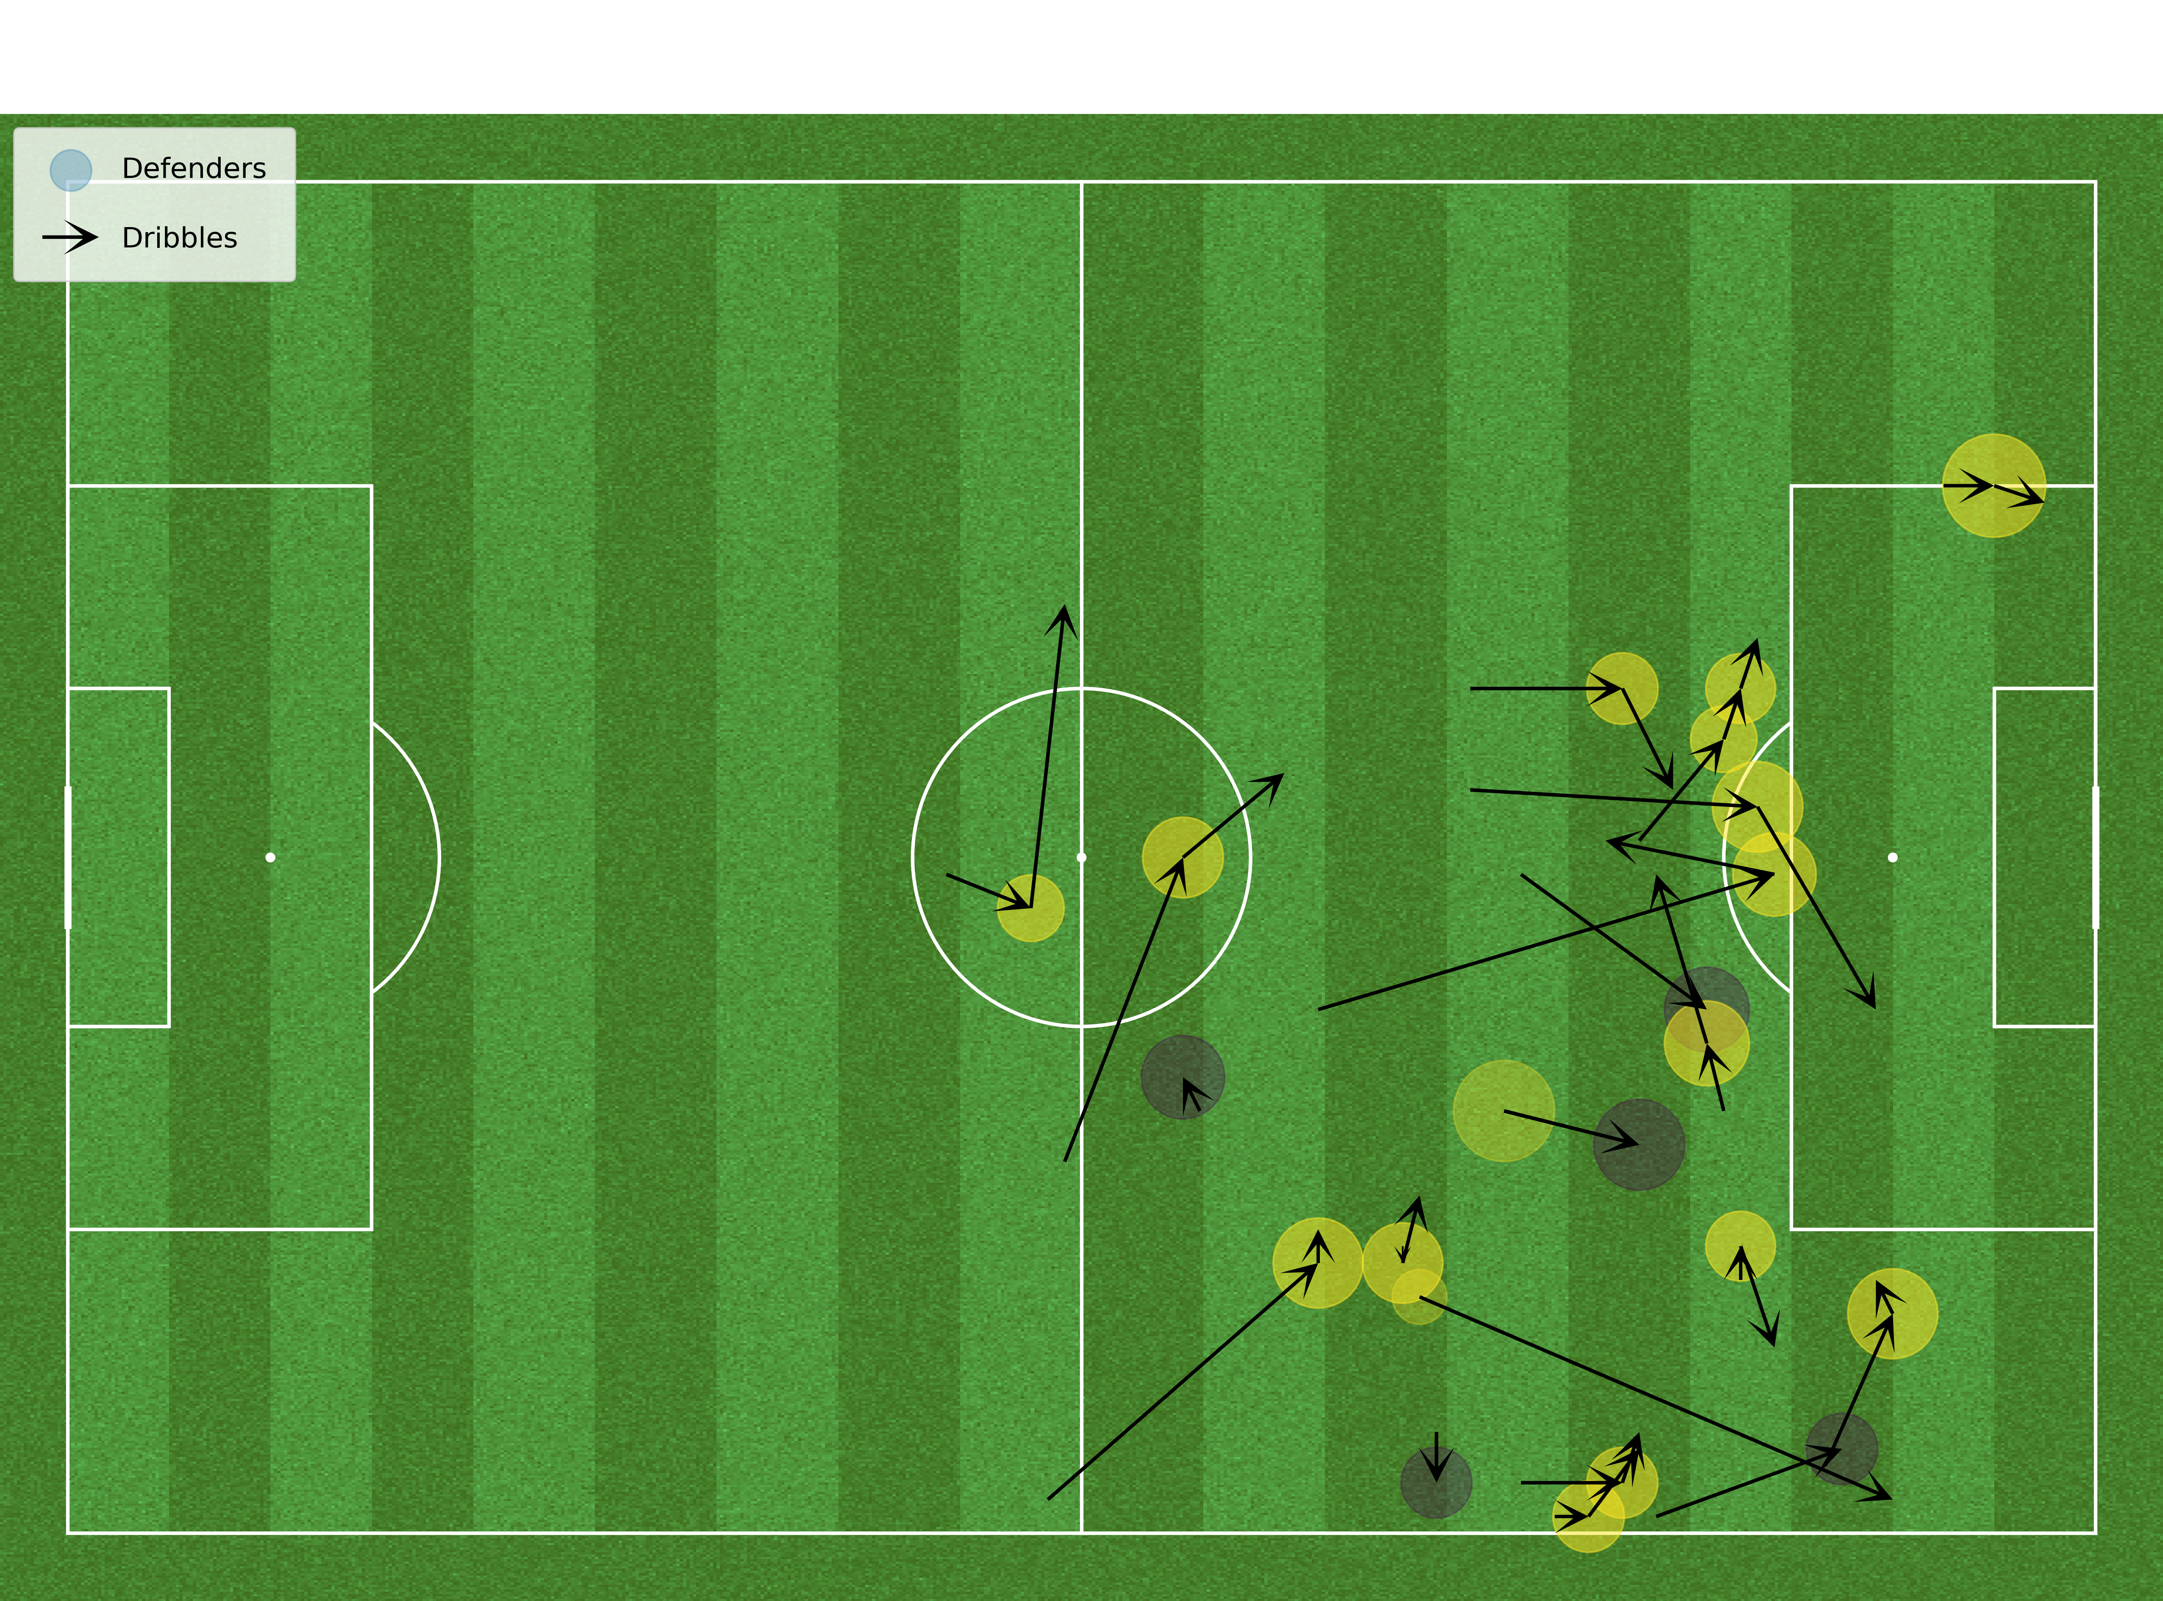
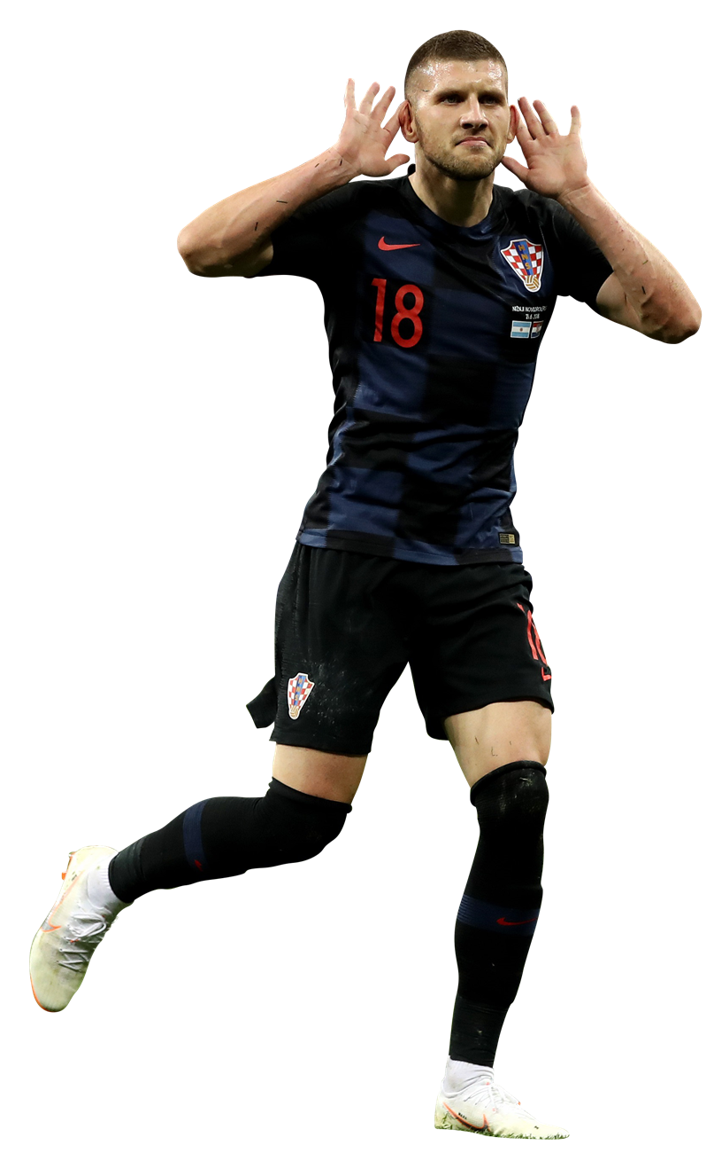
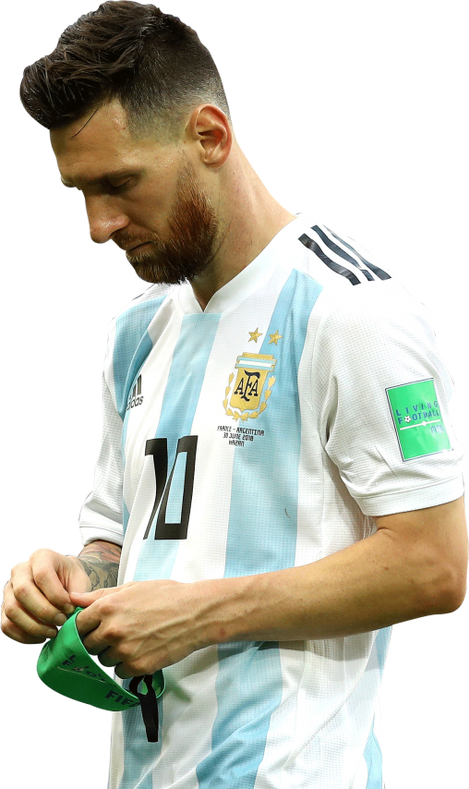
All of Rebić’s dribbles for Croatia
All of Messi’s dribbles for Argentina
Dribble Rank #1 (Elo 215.3)
14 successful dribbles out of 16
Dribble Rank #5 (Elo 199.7)
17 successful dribbles out of 22
Areas of circles represent defensive Elo strength, whilst yellow circles represent successful dribbles.
https://github.com/christiangilson/Mathematical-Modelling-of-Football-Assignments

Slide 4
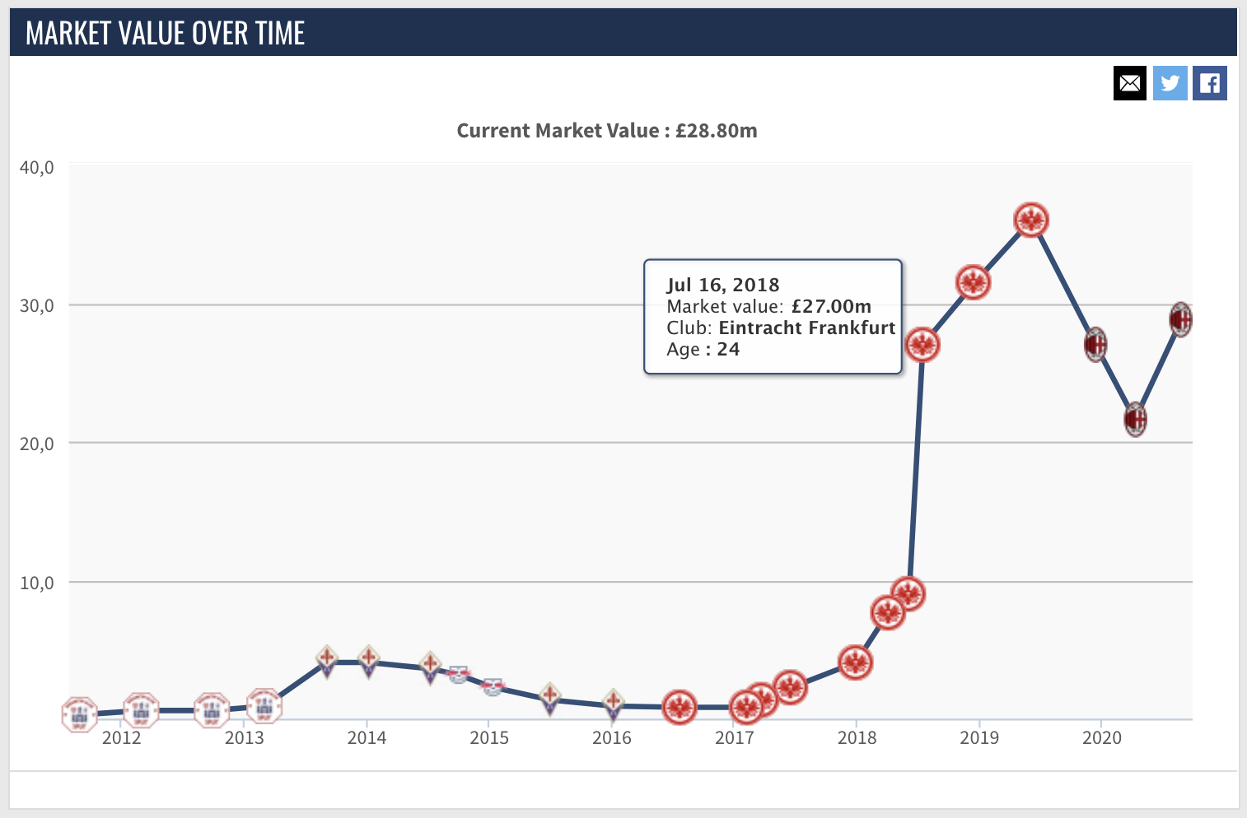
Summary
By combining carry, dribble, dribbled past, and duel event data, we can clearly see Messi’s preference to drift inside as a left-footed right winger, whereas Rebić operated as a second striker with an Henry-esque affinity to drift out to the left.
What’s striking is Rebić’s ability to successfully penetrate the opponent’s penalty area with his dribbles from all angles, finding his way into the box six times and only being stopped once when cutting in from the right.
The only other time Rebić lost the ball was on the left wing against Russia. He came up against an in-form Mário Fernandes at right back who was only beaten once on the dribble all World Cup on his home turf and ranked ninth in the defensive Elo ranking.
Messi on the other hand struggles to penetrate, frequently being ushered around the periphery of the box. What actions Messi did next could be investigated further using additional event types – though a systematic search for the cause may require tracking data to see what’s happening off the ball.
Both the Elo ranking and the visualisation highlight Ante Rebić’s impressive schoolboy style dribbling abilities. What he did with the ball after beating his man is another question (spoiler: he didn’t score once after making it into the box).
Rebić’s stock certainly rose after the World Cup, with newspaper headlines singling him out as the standout player as Croatia tonked Messi’s Argentina 3-0, so he may well have had more to offer than just fancy footwork. It’d be interesting to see how both his dribbling and overall play stack up using action value frameworks – so I shall perhaps return to this analysis later in the course!

